Slide 1



Practice
Collecting Data from Twitter
Digital Business Ecosystem Research Center

Slide 2

Twitter Streaming Importer
This plugin enables you to:
Collect tweets in real-time, on the topic you choose
Get the connections between the users mentioned in these tweets
Visualize these connections in Gephi, or just export all the tweets to Excel

Slide 3
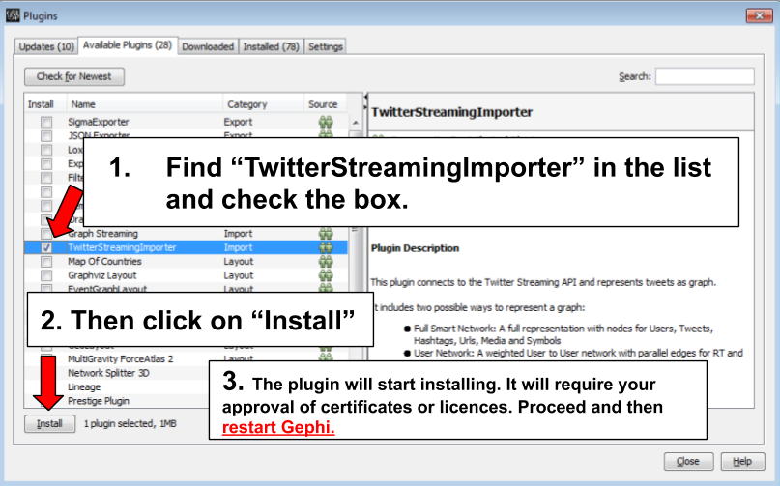
Install Plugin
Choose the menu Tools then Plugins
Click on the tab Available Plugins
Install the plugin then restart Gephi

Slide 4
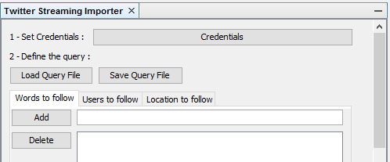
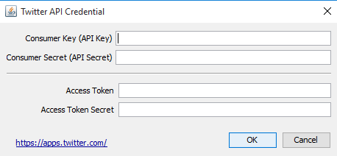
Using the Plugin (1)
Copy paste the codes from Twitter into Gephi
This setup had just to be done once.
Your credentials are saved and will be loaded at each run.
Now we can start using the plugin.

Slide 5
Using the Plugin (2)
Words to follow – able to follow one or multiple words.
Users to follow – able to follow the activity of one or multiple users.
Location to follow – able to follow the activity of one or multiple locations.

Slide 6
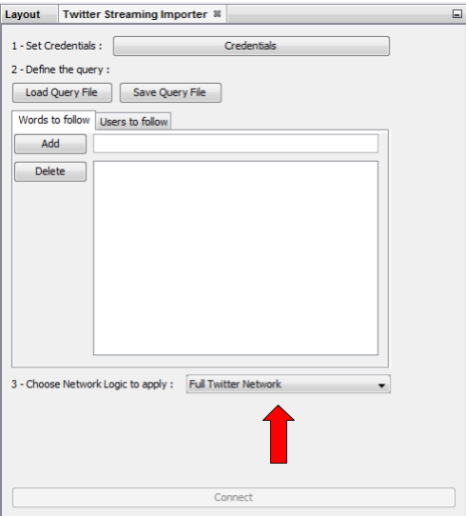
Using the Plugin (3)
Full Twitter Network: This will represent all entities (User, Tweet, Hastags, URL, Media, Symbol etc​) as a graph.
User Network: This will represent the interaction between users. Any mentions, retweets or quotes between 2 users, will be represented. The size of the edge represent the number of interactions between 2 users.
Hashtag Network: This will create the network of Hashtags.
Emoji Network: Same as Hashtag Network but focused on Emoji characters
Bernardamus Projection: This network represents user network via hashtag present in tweets.

Slide 7
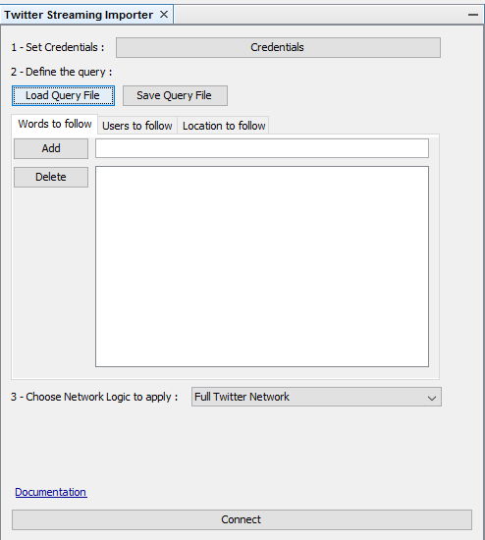
Using the Plugin (4)
Write the term you want to follow
Click on “Add”
Select “User Network”
Click on “Connect”
Click on “Disconnect" to stop the collection of tweets

Slide 8

THANK YOU

